Slide 1
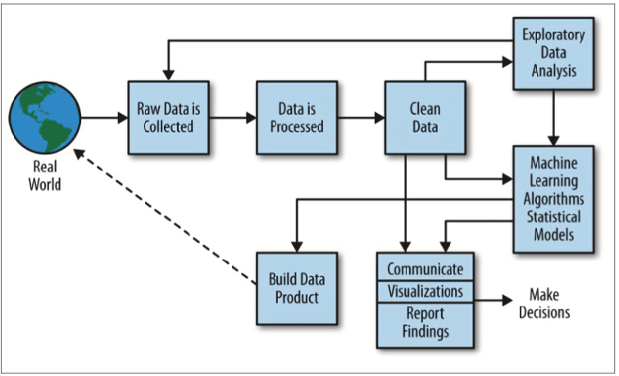
Data Science Process
EDA - IN DATA SCIENCE

Slide 2
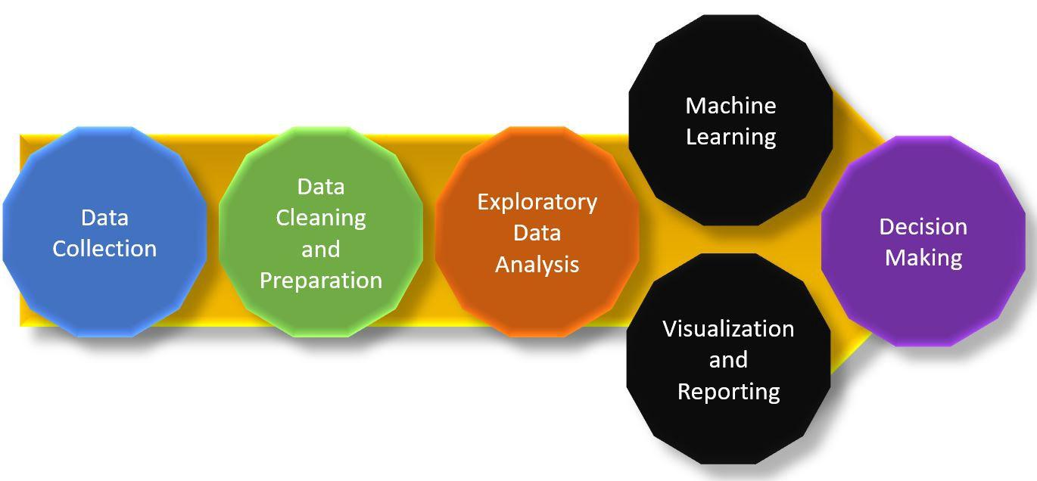
INTRODUCTION TO EDA
Purpose: Data Scientists widely use EDA to understand datasets for decision-making and data cleaning processes. EDA reveals crucial information about the data, such as hidden patterns, outliers, variance, covariance, correlations between features. The information is essential for the hypothesis’s design and creating better-performing models.

Slide 3
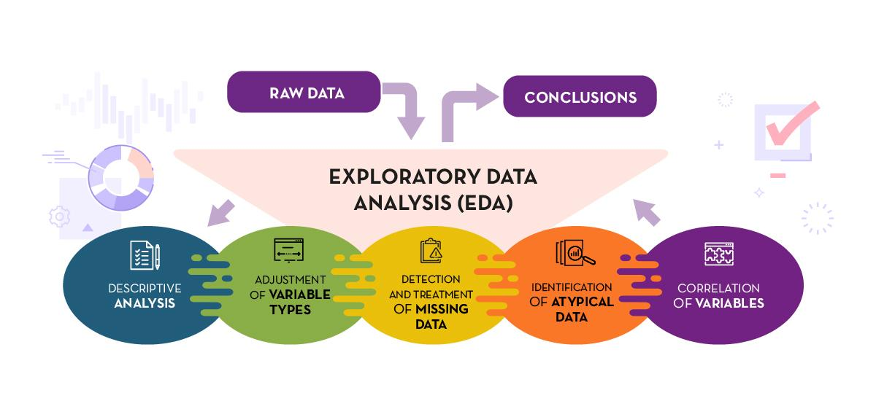
EXPLORATORY DATA ANALYSIS

Slide 4
EDA is used for:-
Catching mistakes and analyses
Gaining new insights into data
Detecting outliers in data
Testing assumptions
Identifying important factors in the data
Understanding relationships

Slide 5


Loans
EDA : Bank Loan Default Risk Analysis

Slide 6
INTRODUCTION:-
This case study aims to give an idea of applying EDA in a real business scenario. In this case study, we will develop a basic understanding of risk analytics in banking and financial services and understand how data is used to minimize the risk of losing money while lending to customers.

Slide 7
Business Understanding:
The loan providing companies find it hard to give loans to the people due to their insufficient or non-existent credit history. Because of that, some consumers use it as their advantage by becoming a defaulter.
You have to use EDA to analyze the patterns present in the data. This will ensure that the applicants capable of repaying the loan are not rejected. When the company receives a loan application, the company has to decide for loan approval based on the applicant’s profile.

Slide 8
Two types of risks are associated with the bank’s decision: FIRST:-
If the applicant is likely to repay the loan, then not approving the loan results in a loss of business to the company
If the applicant is not likely to repay the loan, i.e. he/she is likely to default, then approving the loan may lead to a financial loss for the company.
The data given below contains the information about the loan application at the time of applying for the loan. It contains two types of scenarios:
The client with payment difficulties: he/she had late payment more than X days on at least one of the first Y installments of the loan in our sample
All other cases: All other cases when the payment is paid on time

Slide 9
SECOND:-
When a client applies for a loan, there are four types of decisions that could be taken by the client/company):
Approved: The Company has approved loan Application
Cancelled: The client cancelled the application sometime during approval. Either the client changed her/his mind about the loan or in some cases due to a higher risk of the client he received worse pricing which he did not want.
Refused: The company had rejected the loan (because the client does not meet their requirements etc.)
Unused offer: Loan has been cancelled by the client but on different stages of the process.

Slide 10
Business Objective:
This case study aims to identify patterns which indicate if a client has difficulty paying their installments which may be used for taking actions such as denying the loan, reducing the amount of loan, lending (to risky applicants) at a higher interest rate, etc. This will ensure that the consumers capable of repaying the loan are not rejected. Identification of such applicants using EDA is the aim of this case study.

Slide 11
EDA : Bank Loan Default Risk Analysis
DATA VISUALIZATION

Slide 12
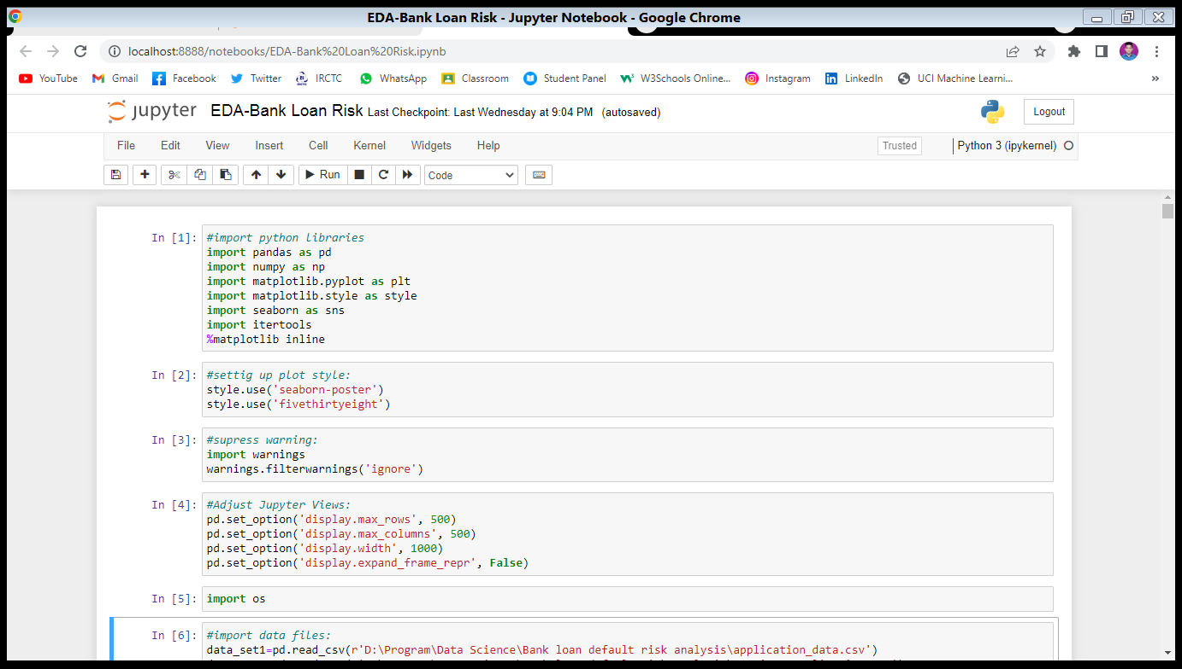
Getting Jupyter Ready:

Slide 13
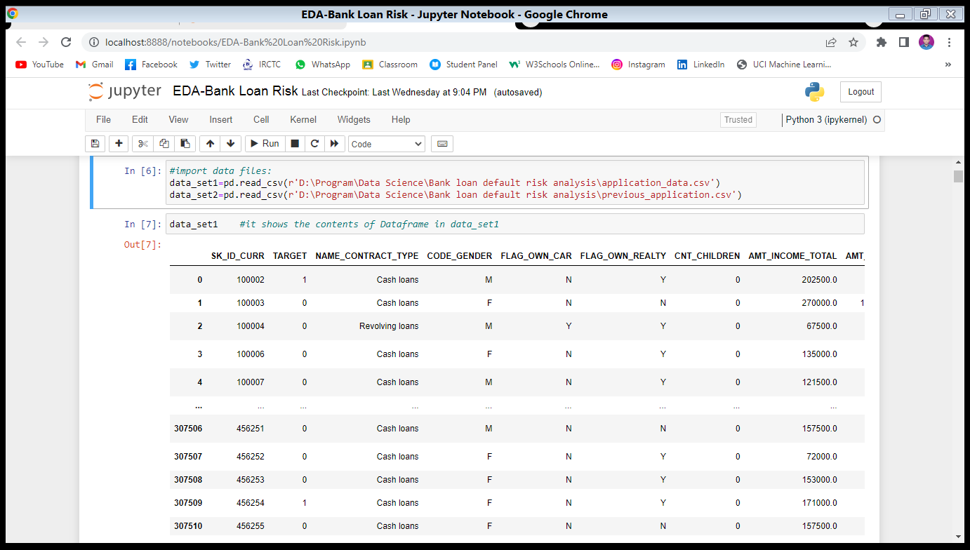
Importing the input files:
🡺 Here I imported two CSV dataset files--- application_data & previous_application with object name-1.data_set1 2.data_set2

Slide 14
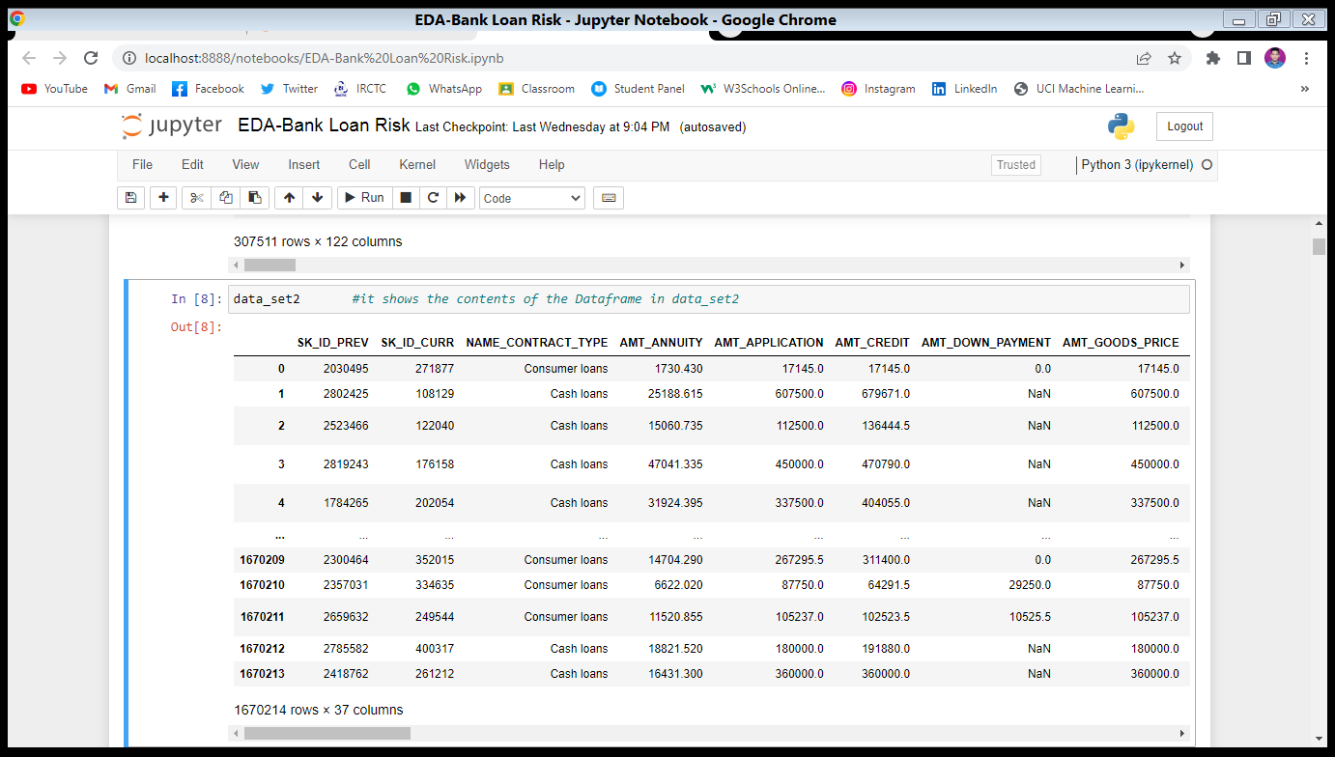

Slide 15
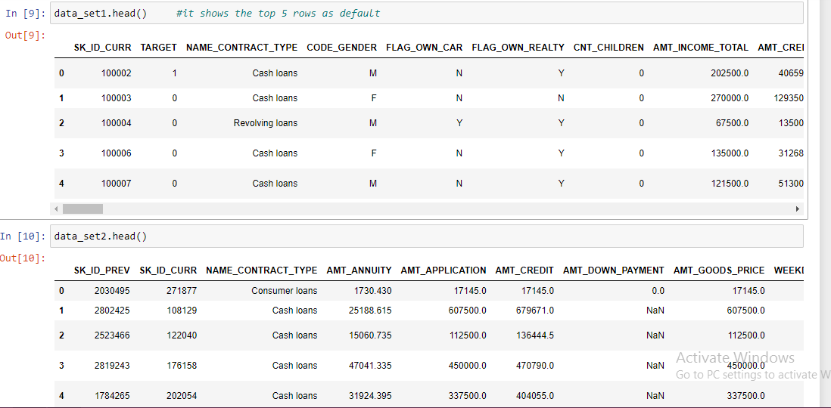

Slide 16
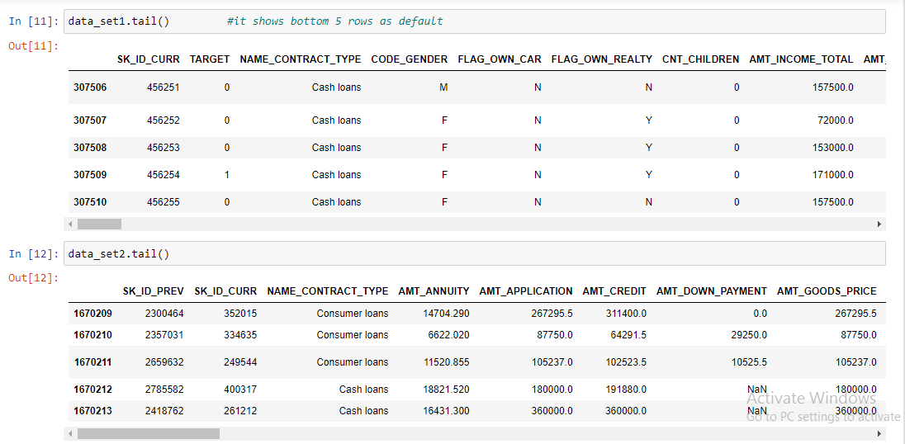

Slide 17
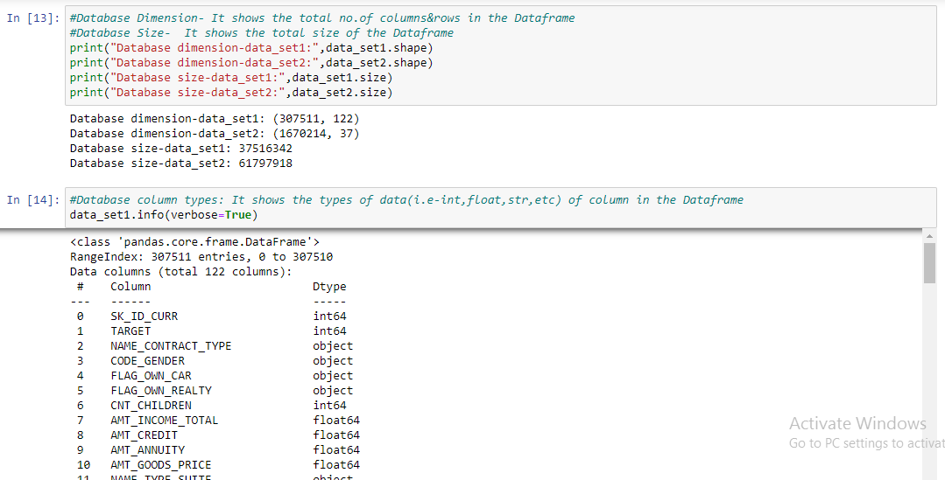

Slide 18
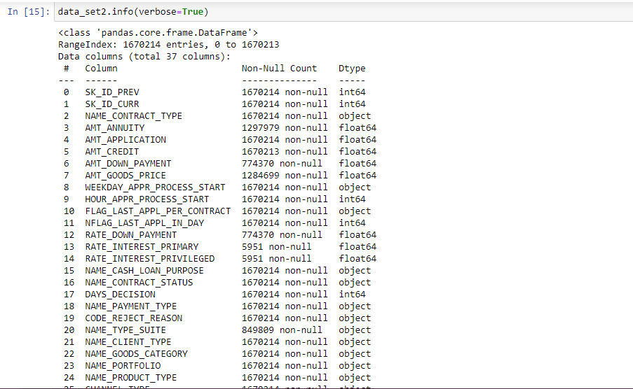

Slide 19
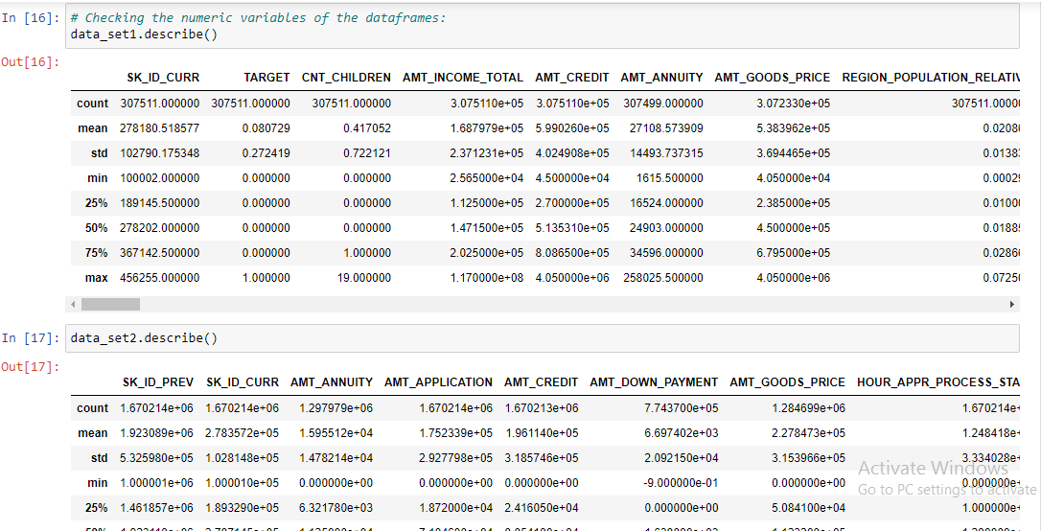

Slide 20
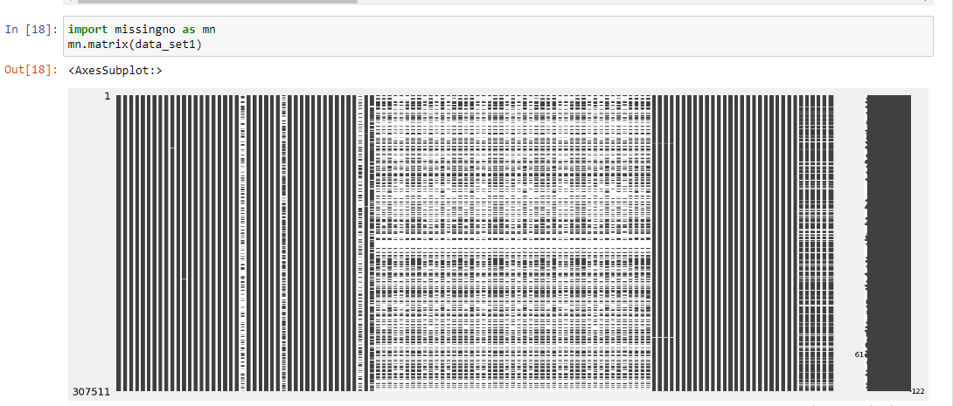
Data Cleaning & Manipulation:
For data_set1:-
Insight: Based on the above Matrix, it is evident that the dataset has many missing values. Let's check for each column what is the % of missing values

Slide 21
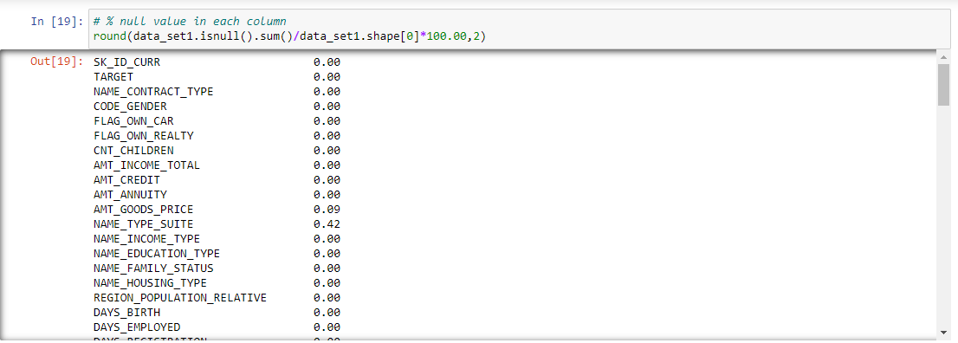
Null Value Calculation:
Insight: There are many columns in data_set1 data frame where missing value is more than 40%. Let's plot the columns vs missing value % with 40% being the cut-off marks

Slide 22
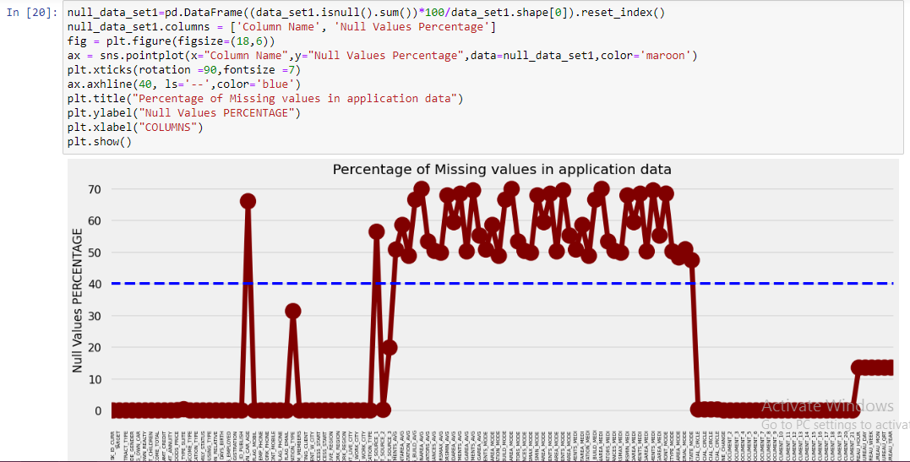
Insight: From the plot we can see the columns in which percentage of null values more than 40% are marked above the blue line and the columns which have less than 40 % null values below the blue line. Let's check the columns which has more than 40% missing values.

Slide 23
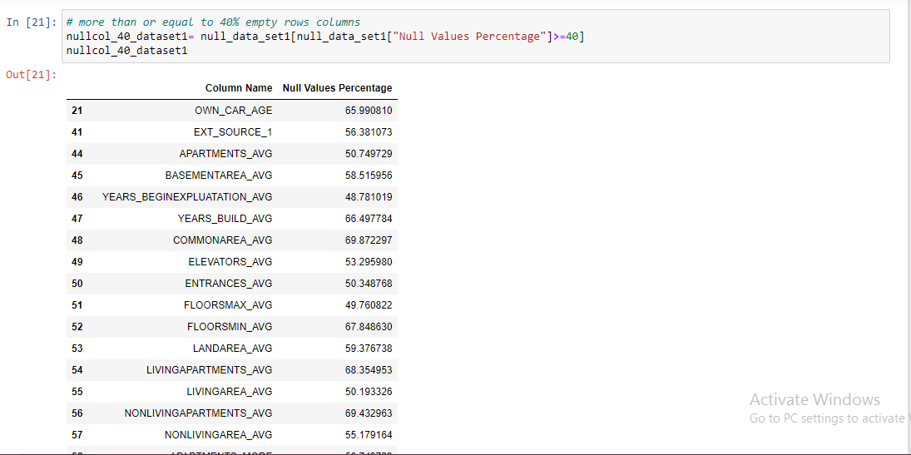
Insight: Total of 49 columns are there which have more than 40% null values. Seems like most of the columns with high missing values are related to different area sizes on apartment owned/rented by the loan applicant.

Slide 24
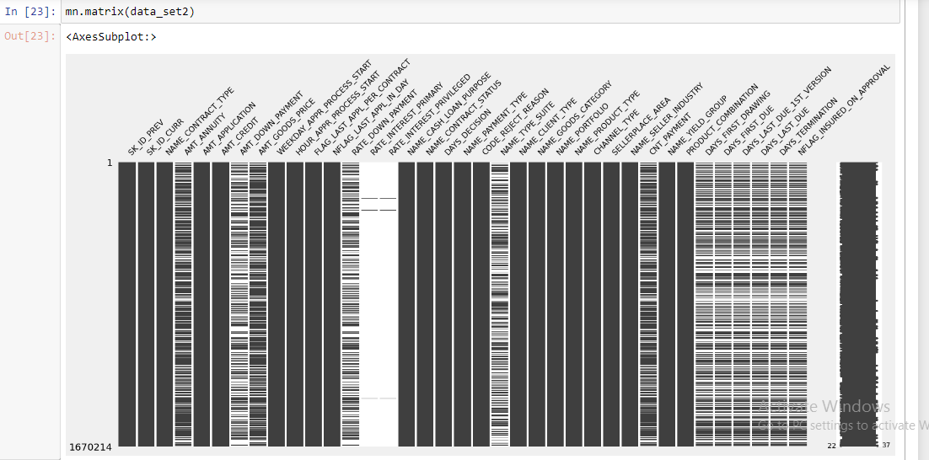
For data_set2:-

Slide 25
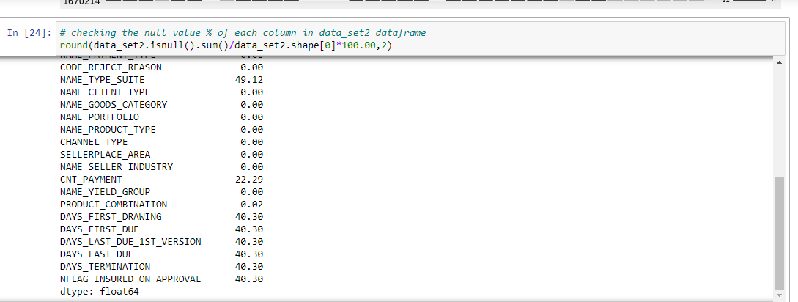
Insight: There are many columns in data_set2 data frame where missing value is more than 40%. Let's plot the columns vs missing value % with 40% being the cut-off marks

Slide 26
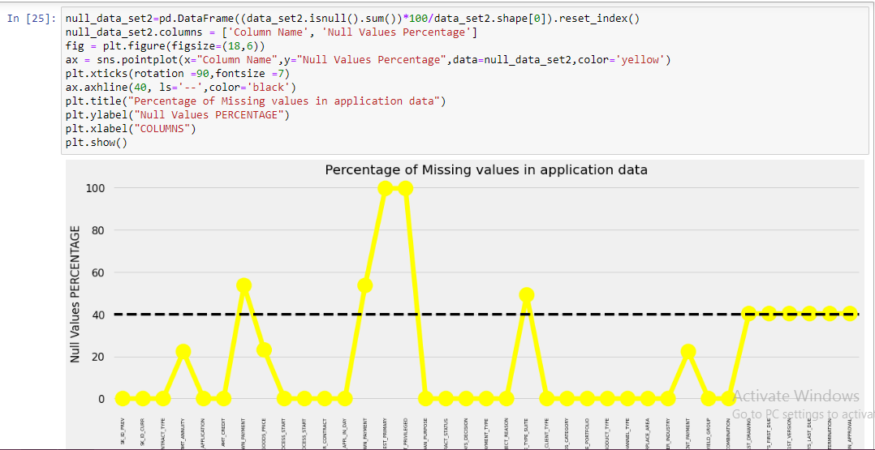
Insight: From the plot we can see the columns in which percentage of null values more than 40% are marked above the black line and the columns which have less than 40 % null values below the black line. Let's check the columns which has more than 40% missing values

Slide 27
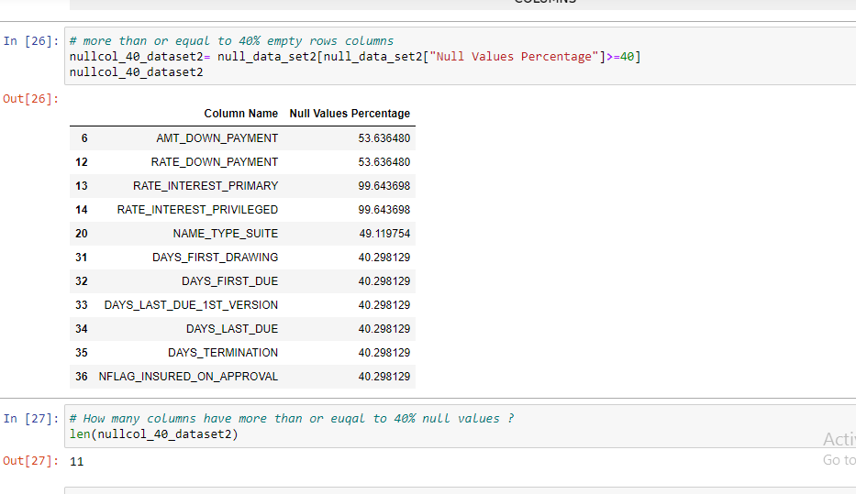
Insight: Total of 11 columns are there which have more than 40% null values. These columns can be deleted. Before deleting these columns, let's review if there are more columns which can be dropped or not[]

Slide 28
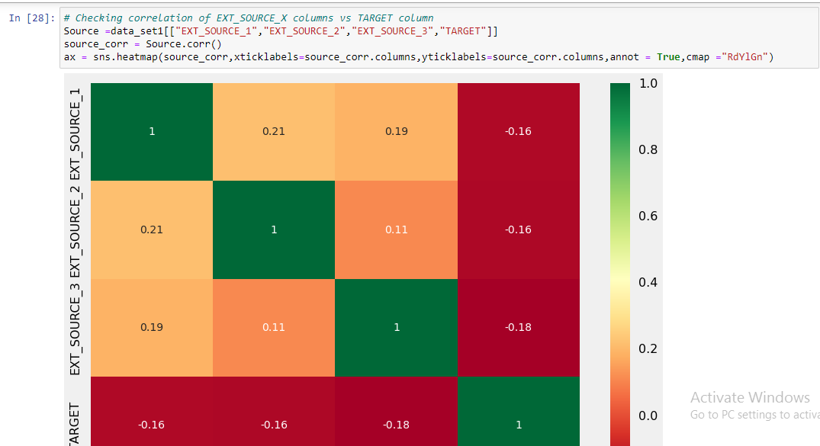
Analyze & Delete Unnecessary Columns in data_set1:
Insight: Based on the above Heat map, we can see there is almost no correlation between EXT_SOURCE_X columns and target column, thus we can drop these columns. EXT_SOURCE_1 has 56% null values, where as EXT_SOURCE_3 has close to 20% null values

Slide 29
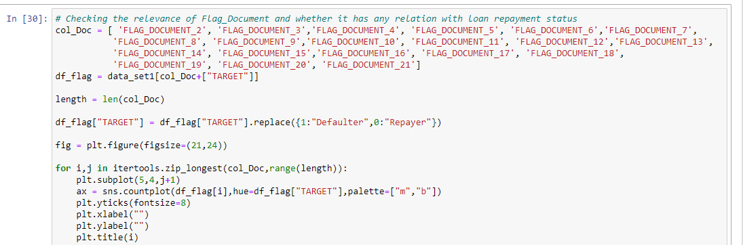
Flag Document:

Slide 30
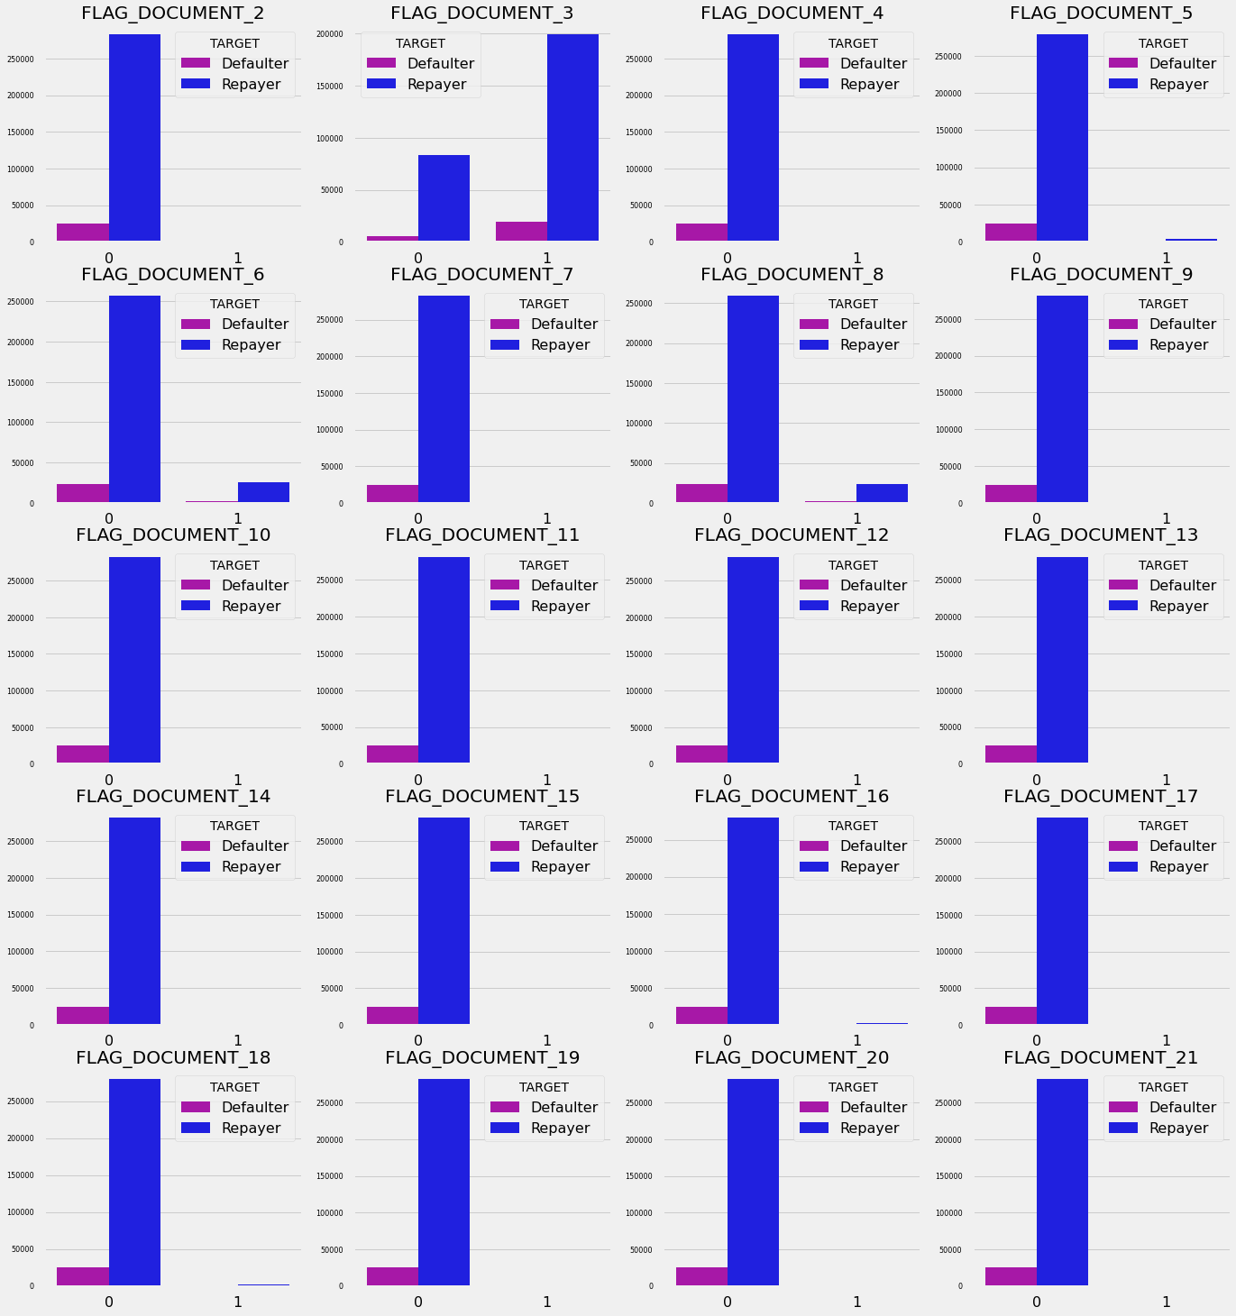
Insight: The above graph shows that in most of the loan application cases, clients who applied for loans has not submitted FLAG_DOCUMENT_X except FLAG_DOCUMENT_3. Thus, Except for FLAG_DOCUMENT_3, we can delete rest of the columns. Data shows if borrower has submitted FLAG_DOCUMENT_3 then there is a less chance of defaulting the loan.

Slide 31
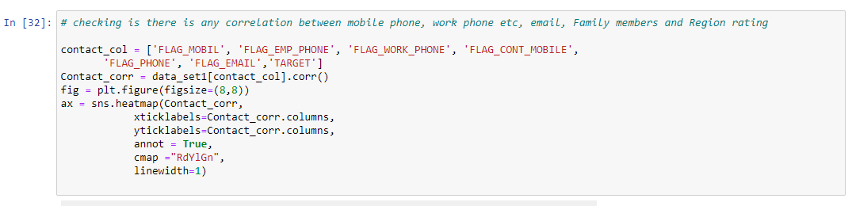
Contact Parameters:

Slide 32
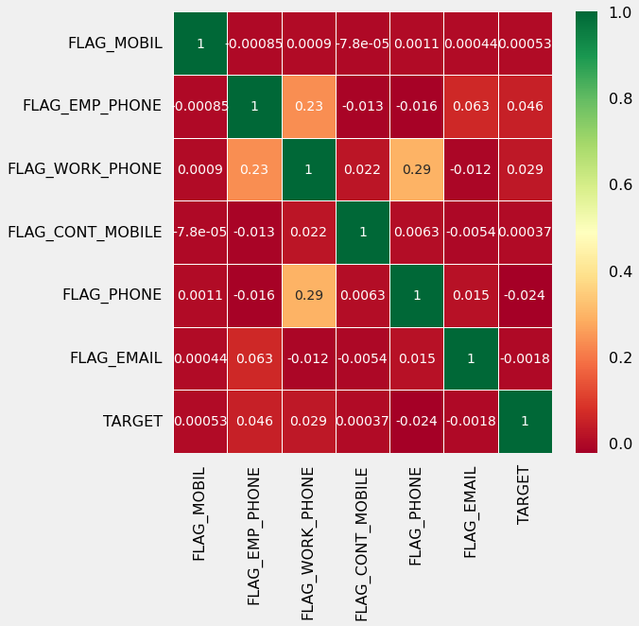
Insight: There is no correlation between flags of mobile phone, email, etc. with loan repayment; thus these columns can be deleted

Slide 33
Standardize Values:
Strategy for data_set1:
🡺Convert DAYS_DECISION,DAYS_EMPLOYED, DAYS_REGISTRATION,DAYS_ID_PUBLISH from negative to positive as days cannot be negative.
🡺Convert DAYS_BIRTH from negative to positive values and calculate age and create categorical bins columns
🡺Categorize the amount variables into bins
🡺Convert region rating column and few other columns to categorical

Slide 34
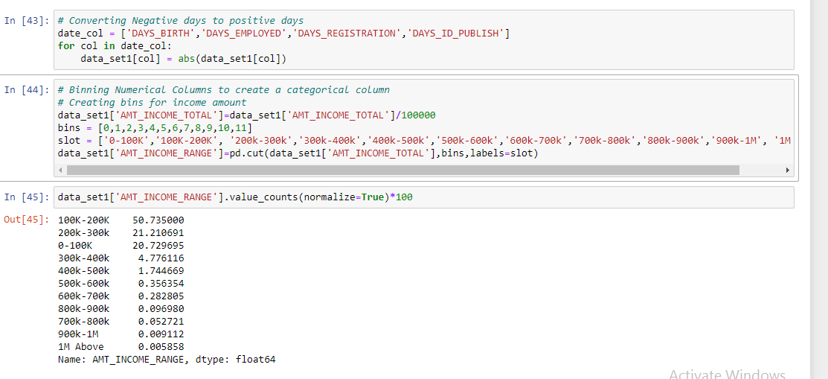
Insight: More than 50% loan applicants have income amount in the range of 100K-200K. Almost 92% loan applicants have income less than 300K

Slide 35
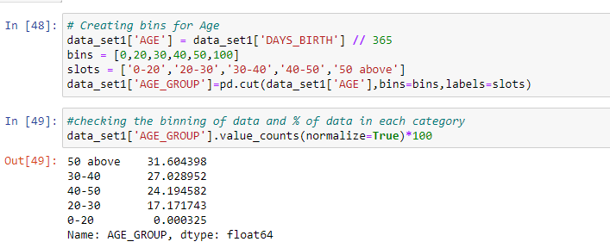
Insight: 31% loan applicants have age above 50 years. More than 55% of loan applicants have age over 40 years.

Slide 36
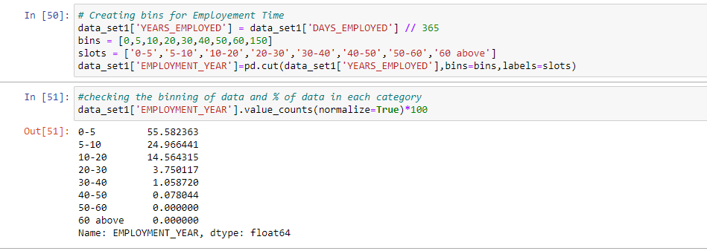
Insight: More than 55% of the loan applicants have work experience within 0-5 years and almost 80% of them have less than 10 years of work experience

Slide 37
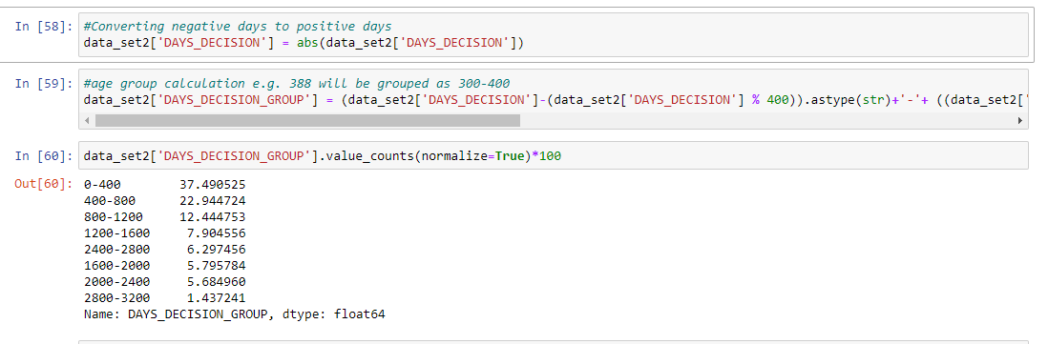
Standardize Values for data_set2:
Strategy for data_set2:
Convert DAYS_DECISION from negative to positive values and create categorical bins columns.
Convert loan purpose and few other columns to categorical.
Insight: Almost 37% loan applicants have applied for a new loan within 0-400 days of previous loan decision

Slide 38
Imputing Null Values in data_set1:
Strategy for data_set1:
To impute null values in categorical variables which has lower null percentage, mode() is used to impute the most frequent items.
To impute null values in categorical variables which has higher null percentage, a new category is created.
To impute null values in numerical variables which has lower null percentage, median() is used as
There are no outliers in the columns
Mean returned decimal values and median returned whole numbers and the columns were number of requests

Slide 39
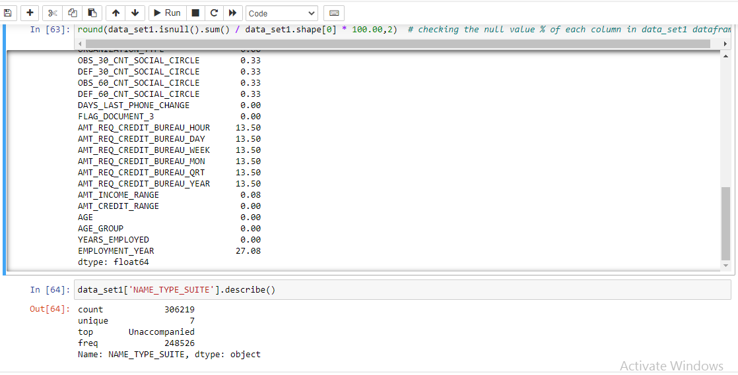

Slide 40
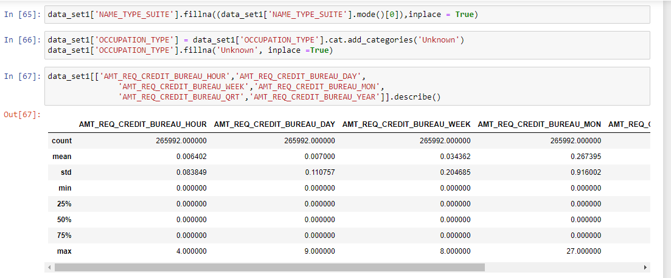

Slide 41
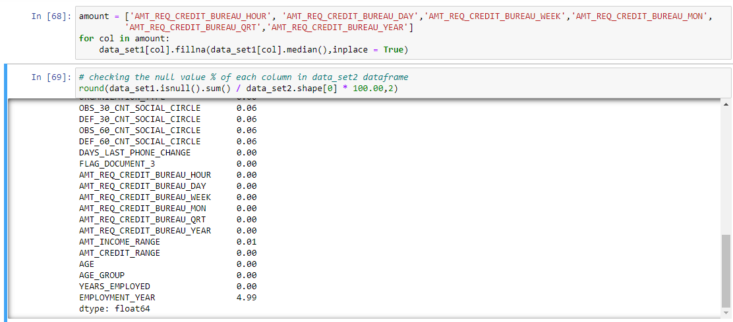
Impute with median as mean has decimals and this is number of requests
Insight: We still have few null values in the columns: AMT_GOODS_PRICE, OBS_30_CNT_SOCIAL_CIRCLE, DEF_30_CNT_SOCIAL_CIRCLE, OBS_60_CNT_SOCIAL_CIRCLE, DEF_60_CNT_SOCIAL_CIRCLE. We can ignore as this percentage is very less.

Slide 42
Imputing Null Values in data_set2:
Strategy for data_set2:
🡺To impute null values in numerical column, we analyzed the loan status and assigned values.
🡺To impute null values in continuous variables, we plotted the distribution of the columns and used
median if the distribution is skewed
mode if the distribution pattern is preserved.

Slide 43
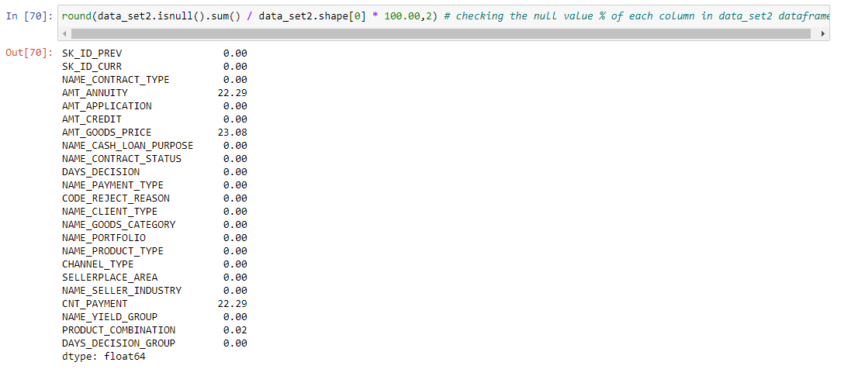

Slide 44
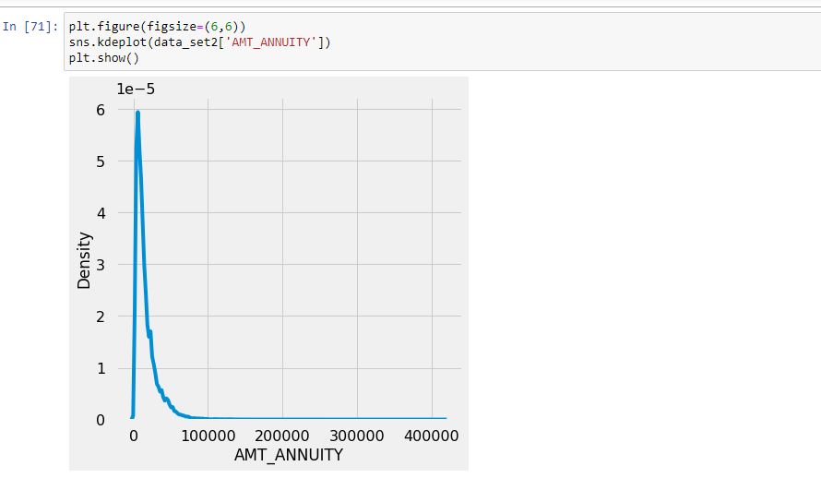
Impute AMT_ANNUITY with median as the distribution is greatly skewed:
Insight: There is a single peak at the left side of the distribution and it indicates the presence of outliers and hence imputing with mean would not be the right approach and hence imputing with median.

Slide 45
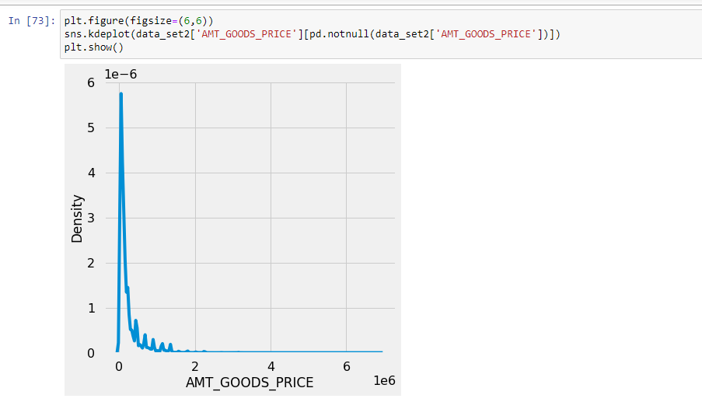
Impute AMT_GOODS_PRICE with mode as the distribution is closely similar:
There are several peaks along the distribution. Let's impute using the mode, mean and median and see if the distribution is still about the same.

Slide 46
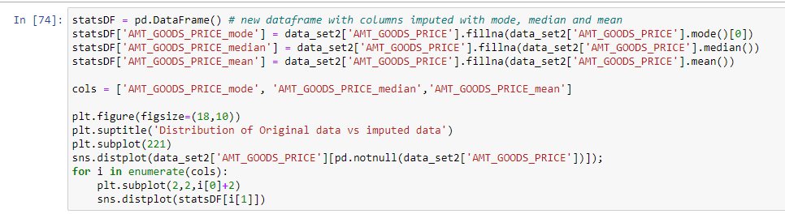
There are several peaks along the distribution. Let's impute using the mode, mean and median and see if the distribution is still about the same.

Slide 47
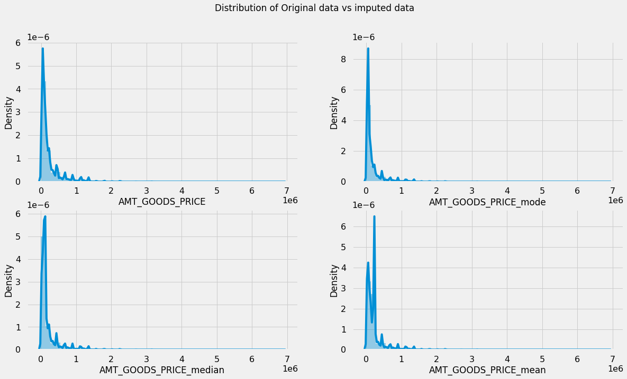
Insight: The original distribution is closer with the distribution of data imputed with mode in this case

Slide 48
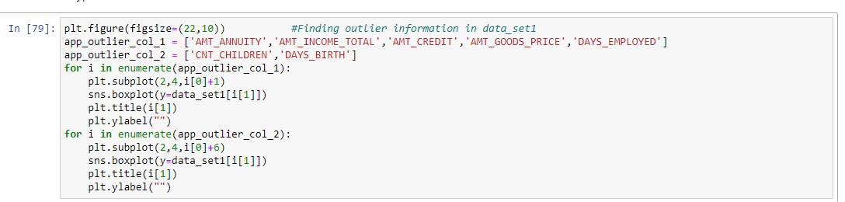
Identifying the outliers:
Finding outlier information in data_set1

Slide 49
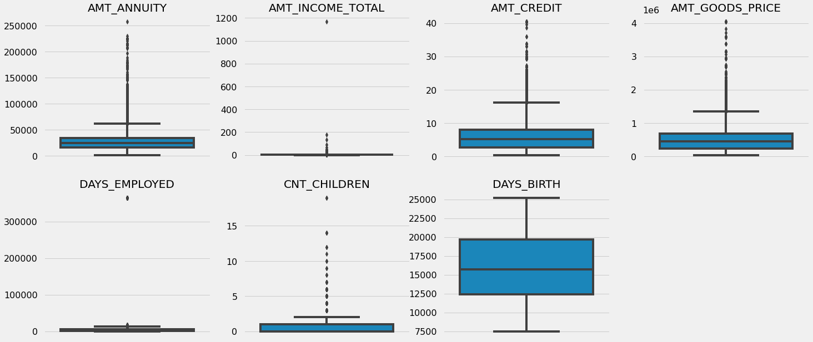
Insight: It can be seen that in current application dataAMT_ANNUITY, AMT_CREDIT, AMT_GOODS_PRICE,CNT_CHILDREN have some number of outliers.
AMT_INCOME_TOTAL has huge number of outliers which indicate that few of the loan applicants have high income when compared to the others.
DAYS_BIRTH has no outliers which means the data available is reliable.
DAYS_EMPLOYED has outlier values around 350000(days) which is around 958 years which is impossible and hence this has to be incorrect entry.

Slide 50
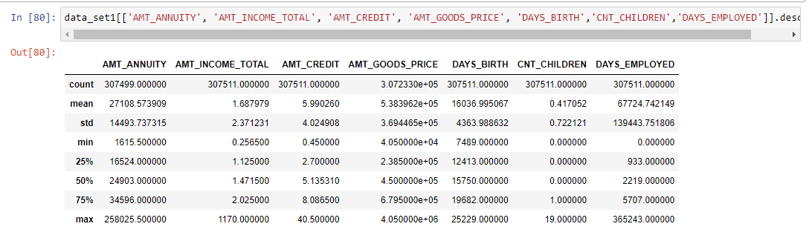
We can see the stats for these columns below as well

Slide 51
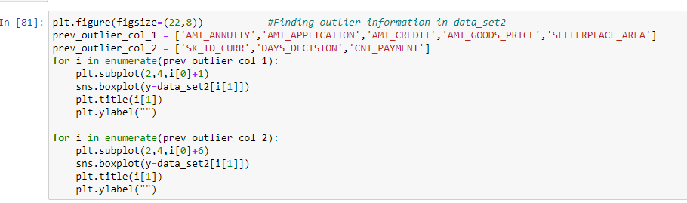
Finding outlier information in data_set2:

Slide 52
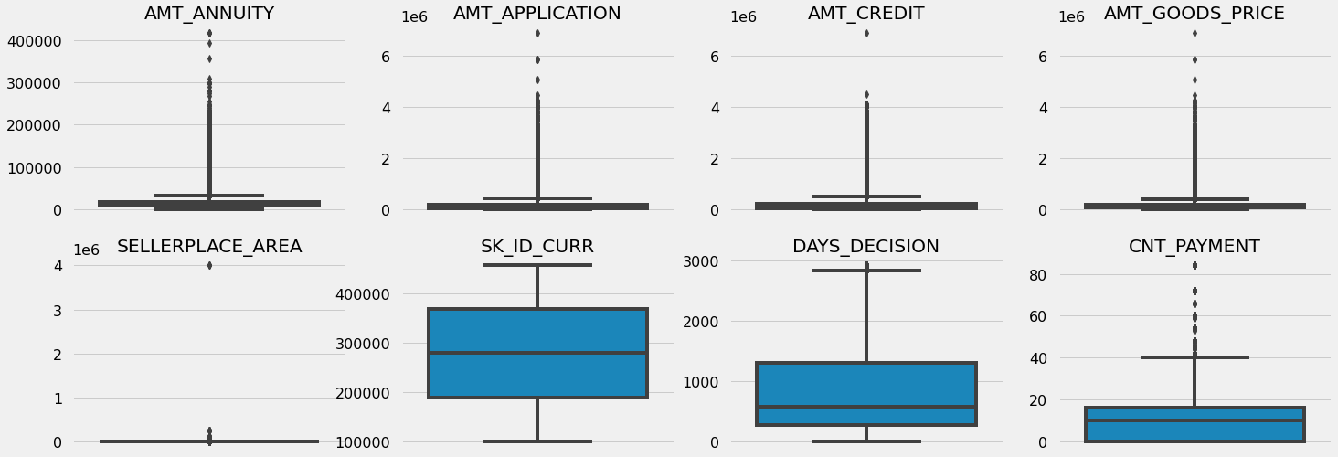
Insight:
AMT_ANNUITY, AMT_APPLICATION, AMT_CREDIT, AMT_GOODS_PRICE, SELLERPLACE_AREA have huge number of outliers
CNT_PAYMENT has few outlier values.
SK_ID_CURR is an ID column and hence no outliers.
DAYS_DECISION has little number of outliers indicating that these previous applications decisions were taken long back.

Slide 53
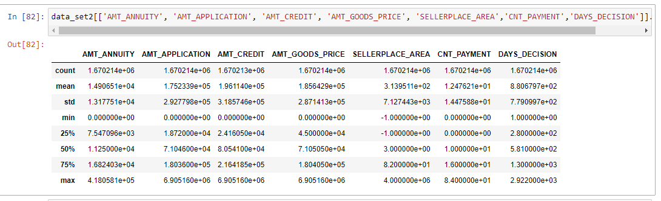
We can see the stats for these columns below as well

Slide 54
Data Analysis:
Strategy:
The data analysis flow has been planned in following way
Imbalance in Data
Categorical Data Analysis
Categorical segmented Univariate Analysis
Categorical Bi/Multivariate analysis
Numeric Data Analysis
Bi-furcation of databased based on TARGET data
Correlation Matrix
Numerical segmented Univariate Analysis
Numerical Bi/Multivariate analysis

Slide 55
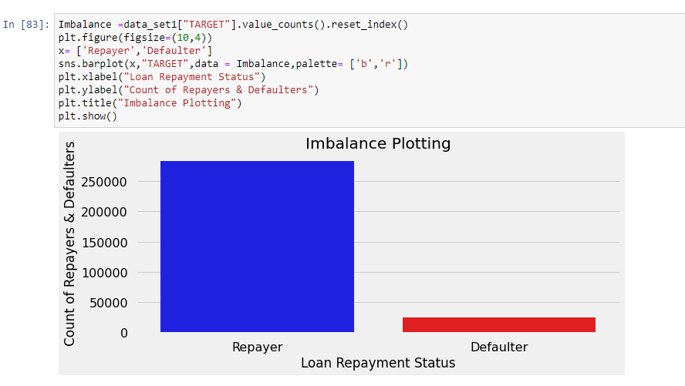
Imbalance Analysis:

Slide 56
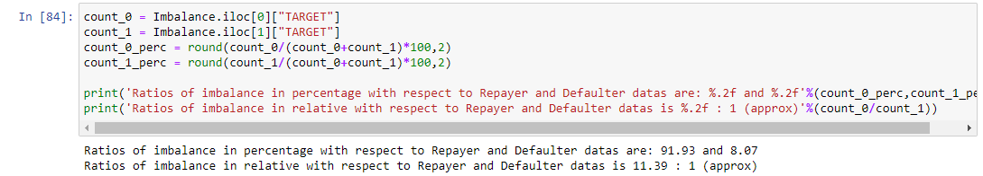

Slide 57
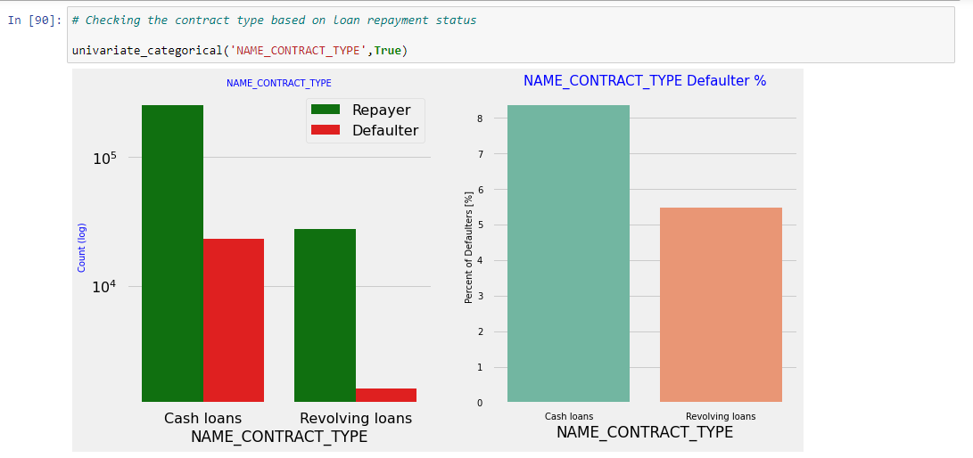
Categorical Variables Analysis:
Segmented Univariate Analysis:
Inferences: Contract type: Revolving loans are just a small fraction (10%) from the total number of loans; in the same time, a larger amount of Revolving loans, comparing with their frequency, are not repaid.

Slide 58
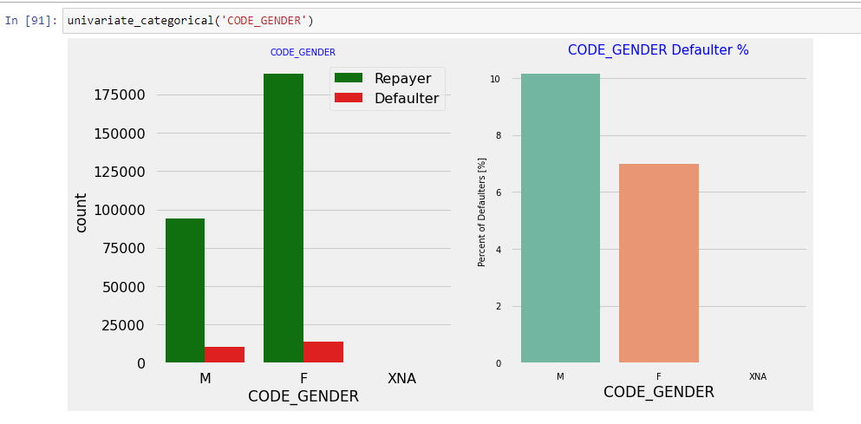
Inferences: The number of female clients is almost double the number of male clients. Based on the percentage of defaulted credits, males have a higher chance of not returning their loans (~10%), comparing with women (~7%)

Slide 59
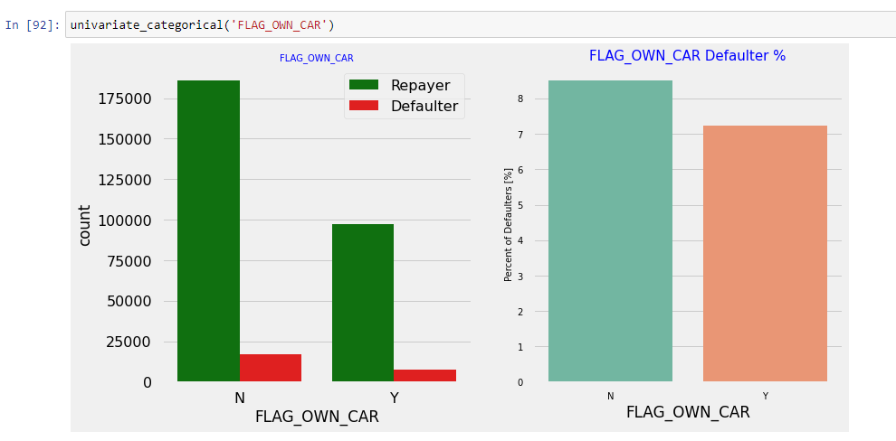
Inferences: Clients who own a car are half in number of the clients who don’t own a car. But based on the percentage of default, there is no correlation between owning a car and loan repayment as in both cases the default percentage is almost same.

Slide 60
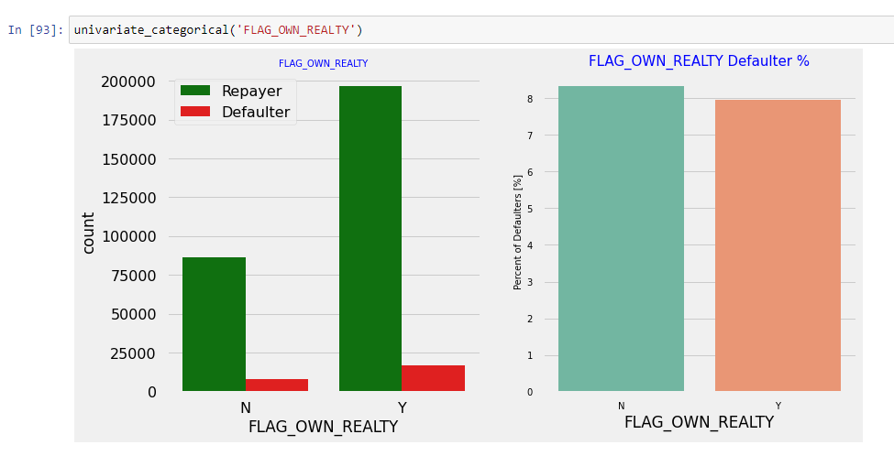
Inferences: The clients who own real estate are more than double of the ones that don't own. But the defaulting rate of both categories are around the same (~8%). Thus there is no correlation between owning a reality and defaulting the loan.

Slide 61
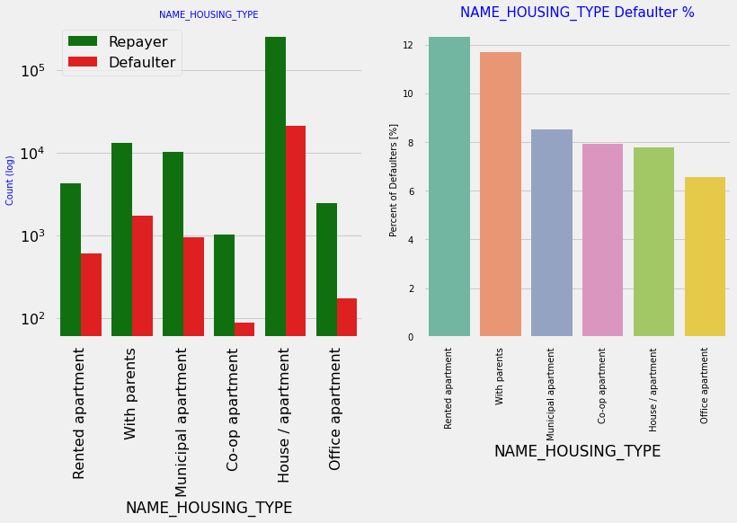
Inferences:
Majority of people live in House/apartment
People living in office apartments have lowest default rate
People living with parents (~11.5%) and living in rented apartments(>12%) have higher probability of defaulting

Slide 62
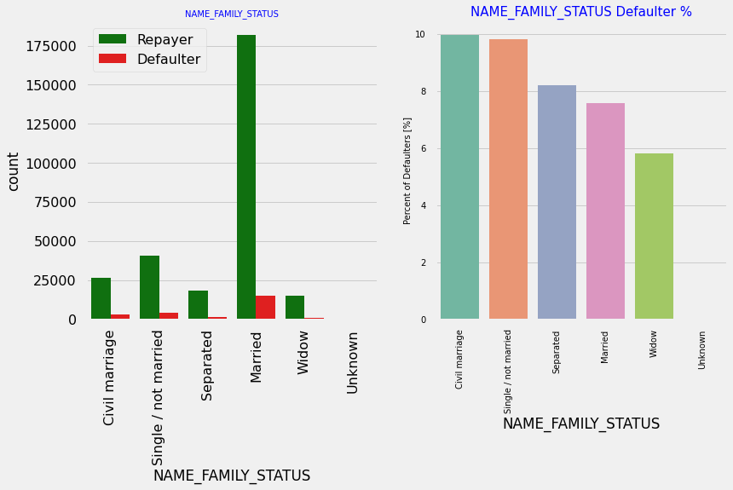
Inferences:
Most of the people who have taken loan are married, followed by Single/not married and civil marriage
In terms of percentage of not repayment of loan, Civil marriage has the highest percent of not repayment (10%), with Widow the lowest (exception being Unknown).

Slide 63

Inferences:
Majority of the clients have Secondary / secondary special education, followed by clients with Higher education. Only a very small number having an academic degree
The Lower secondary category, although rare, have the largest rate of not returning the loan (11%). The people with Academic degree have less than 2% defaulting rate.

Slide 64

Inferences:
Most of applicants for loans have income type as Working, followed by Commercial associate, Pensioner and State servant.
The applicants with the type of income Maternity leave have almost 40% ratio of not returning loans, followed by Unemployed (37%). The rest of types of incomes are under the average of 10% for not returning loans.
Student and Businessmen, though less in numbers do not have any default record. Thus these two category are safest for providing loan.

Slide 65

Inferences:
Most of the applicants are living in Region Rating 2 place.
Region Rating 3 has the highest default rate (11%)
Applicant living in Region Rating 1 has the lowest probability of defaulting, thus safer for approving loans

Slide 66

Inferences:
Most of the loans are taken by Laborers, followed by Sales staff. IT staff take the lowest amount of loans.
The category with highest percent of not repaid loans are Low-skill Laborers (above 17%), followed by Drivers and Waiters/barmen staff, Security staff, Laborers and Cooking staff.

Slide 67

Inferences:
Organizations with highest percent of loans not repaid are Transport: type 3 (16%), Industry: type 13 (13.5%), Industry: type 8 (12.5%) and Restaurant (less than 12%). Self employed people have relative high defaulting rate, and thus should be avoided to be approved for loan or provide loan with higher interest rate to mitigate the risk of defaulting.
Most of the people application for loan are from Business Entity Type 3
For a very high number of applications, Organization type information is unavailable(XNA)
It can be seen that following category of organization type has lesser defaulters thus safer for providing loans: Trade Type 4 and 5
Industry type 8

Slide 68

Inferences: There is no significant correlation between re-payers and defaulters in terms of submitting document 3 as we see even if applicants have submitted the document, they have defaulted a slightly more (~9%) than who have not submitted the document (6%)

Slide 69

Inferences:
People in the age group range 20-40 have higher probability of defaulting
People above age of 50 have low probability of defaulting

Slide 70

Inferences:
Majority of the applicants have been employed in between 0-5 years. The defaulting rating of this group is also the highest which is 10%
With increase of employment year, defaulting rate is gradually decreasing with people having 40+ year experience having less than 1% default rate

Slide 71

Inferences:
More than 80% of the loan provided are for amount less than 900,000
People who get loan for 300-600k tend to default more than others.

Slide 72

Inferences:
90% of the applications have Income total less than 300,000
Application with Income less than 300,000 has high probability of defaulting
Applicant with Income more than 700,000 are less likely to default

Slide 73

Inferences:
Most of the applicants do not have children
Very few clients have more than 3 children.
Client who have more than 4 children has a very high default rate with child count 9 and 11 showing 100% default rate

Slide 74

Inferences: Family member follows the same trend as children where having more family members increases the risk of defaulting

Slide 75

Categorical Bi/Multivariate Analysis

Slide 76

Inferences: It can be seen that business man's income is the highest and the estimated range with default 95% confidence level seem to indicate that the income of a business man could be in the range of slightly close to 4 lakhs and slightly above 10 lakhs

Slide 77

Correlation between numeric variable:

Slide 78

Inferences: Correlating factors amongst re-payers: Credit amount is highly correlated with amount of goods price
loan annuity
total income
We can also see that re-payers have high correlation in number of days employed.

Slide 79


Slide 80


Slide 81
Inferences:
Credit amount is highly correlated with amount of goods price which is same as re-payers.
But the loan annuity correlation with credit amount has slightly reduced in defaulters(0.75) when compared to re-payers(0.77)
We can also see that re-payers have high correlation in number of days employed(0.62) when compared to defaulters(0.58).
There is a severe drop in the correlation between total income of the client and the credit amount(0.038) amongst defaulters whereas it is 0.342 among re-payers.
Days_birth and number of children correlation has reduced to 0.259 in defaulters when compared to 0.337 in re-payers.
There is a slight increase in defaulted to observed count in social circle among defaulters(0.264) when compared to re-payers(0.254)

Slide 82

Numerical Univariate Analysis:

Slide 83

Inferences:
Most no of loans are given for goods price below 10 lakhs
Most people pay annuity below 50000 for the credit loan
Credit amount of the loan is mostly less then 10 lakhs
The re-payers and defaulters distribution overlap in all the plots and hence we cannot use any of these variables in isolation to make a decision

Slide 84


Numerical Bivariate Analysis:
Inferences: When the credit amount goes beyond 3M, there is an increase in defaulters.

Slide 85

Inferences:
When amt_annuity >15000 amt_goods_price> 3M, there is a lesser chance of defaulters
AMT_CREDIT and AMT_GOODS_PRICE are highly correlated as based on the scatterplot where most of the data are consolidated in form of a line
There are very less defaulters for AMT_CREDIT >3M
Inferences related to distribution plot has been already mentioned in previous dist.plot graphs inferences section

Slide 86

Merged Data-frames Analysis:

Slide 87



Slide 88
Plotting Contract Status vs purpose of the loan:

Slide 89


Slide 90


Slide 91
Inferences:
Loan purpose has high number of unknown values (XAP, XNA)
Loan taken for the purpose of Repairs seems to have highest default rate
A very high number application have been rejected by bank or refused by client which has purpose as repair or other. This shows that purpose repair is taken as high risk by bank and either they are rejected or bank offers very high loan interest rate which is not feasible by the clients, thus they refuse the loan.

Slide 92




Slide 93

Inferences:
90% of the previously cancelled client have actually re-payed the loan. Revisiting the interest rates would increase business opportunity for these clients
88% of the clients who have been previously refused a loan has payed back the loan in current case.
Refusal reason should be recorded for further analysis as these clients would turn into potential repaying customer.

Slide 94

Inferences: The point plot show that the people who have not used offer earlier have defaulted even when there average income is higher than others

Slide 95
Inferences: Clients who have average of 0.13 or higher DEF_60_CNT_SOCIAL_CIRCLE score tend to default more and hence client's social circle has to be analyzed before providing the loan.
Conclusion:
🡺After analyzing the datasets, there are few attributes of a client with which the bank would be able to identify if they will repay the loan or not.
🡺The analysis is consisted as below with the contributing factors and categorization:

Slide 96
Decisive Factor whether an applicant will be Re-payer:
NAME_EDUCATION_TYPE: Academic degree has less defaults.
NAME_INCOME_TYPE: Student and Businessmen have no defaults.
REGION_RATING_CLIENT: RATING1 is safer.
ORGANIZATION_TYPE: Clients with Trade Type 4 and 5 and Industry type 8 have defaulted less than 3%
DAYS_BIRTH: People above age of 50 have low probability of defaulting
DAYS_EMPLOYED: Clients with 40+ year experience having less than 1% default rate
AMT_INCOME_TOTAL:Applicant with Income more than 700,000 are less likely to default
NAME_CASH_LOAN_PURPOSE: Loans bought for Hobby, Buying garage are being re-payed mostly.
CNT_CHILDREN: People with zero to two children tend to repay the loans.

Slide 97
Decisive Factor whether an applicant will be Defaulter:
CODE_GENDER: Men are at relatively higher default rate
NAME_FAMILY_STATUS : People who have civil marriage or who are single default a lot.
NAME_EDUCATION_TYPE: People with Lower Secondary & Secondary education
NAME_INCOME_TYPE: Clients who are either at Maternity leave OR Unemployed default a lot.
REGION_RATING_CLIENT: People who live in Rating 3 has highest defaults.
OCCUPATION_TYPE: Avoid Low-skill Laborers, Drivers and Waiters/barmen staff, Security staff, Laborers and Cooking staff as the default rate is huge.
ORGANIZATION_TYPE: Organizations with highest percent of loans not repaid are Transport: type 3 (16%), Industry: type 13 (13.5%), Industry: type 8 (12.5%) and Restaurant (less than 12%). Self-employed people have relative high defaulting rate, and thus should be avoided to be approved for loan or provide loan with higher interest rate to mitigate the risk of defaulting.
DAYS_BIRTH: Avoid young people who are in age group of 20-40 as they have higher probability of defaulting
DAYS_EMPLOYED: People who have less than 5 years of employment have high default rate.
CNT_CHILDREN & CNT_FAM_MEMBERS: Client who have children equal to or more than 9 default 100% and hence their applications are to be rejected.
AMT_GOODS_PRICE: When the credit amount goes beyond 3M, there is an increase in defaulters.

Slide 98
The following attributes indicate that people from these category tend to default but then due to the number of people and the amount of loan, the bank could provide loan with higher interest to mitigate any default risk thus preventing business loss:
NAME_HOUSING_TYPE: High number of loan applications are from the category of people who live in Rented apartments & living with parents and hence offering the loan would mitigate the loss if any of those default.
AMT_CREDIT: People who get loan for 300-600k tend to default more than others and hence having higher interest specifically for this credit range would be ideal.
AMT_INCOME: Since 90% of the applications have Income total less than 300,000 and they have high probability of defaulting, they could be offered loan with higher interest compared to other income category.
CNT_CHILDREN & CNT_FAM_MEMBERS: Clients who have 4 to 8 children has a very high default rate and hence higher interest should be imposed on their loans.
NAME_CASH_LOAN_PURPOSE: Loan taken for the purpose of Repairs seems to have highest default rate. A very high number applications have been rejected by bank or refused by client in previous applications as well which has purpose as repair or other. This shows that purpose repair is taken as high risk by bank and either they are rejected, or bank offers very high loan interest rate which is not feasible by the clients, thus they refuse the loan. The same approach could be followed in future as well.

Slide 99
Other suggestions:
90% of the previously cancelled client have actually re-payed the loan. Record the reason for cancellation which might help the bank to determine and negotiate terms with these repaying customers in future for increase business opportunity.
88% of the clients who were refused by bank for loan earlier have now turned into a repaying client. Hence documenting the reason for rejection could mitigate the business loss and these clients could be contacted for further loans.

Slide 100

Thank You

